Slide 1
Enhancing the student learning experience during the Year Abroad
Robert Blackwood

Slide 2
Challenges identified
Damaging to one’s degree:
Cost
Detrimental effect on academic performance
Disconnect from one’s peer group

Slide 3
Support for students
The challenge of enhancing the student experience in a different fees environment
Mobile technology as a double-edged sword

Slide 4
On-line supervision
The options

Slide 5
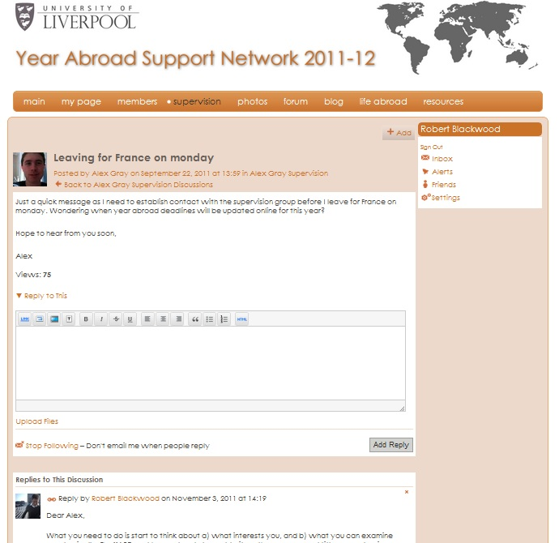
On-line supervision
Year Abroad Network

Slide 6
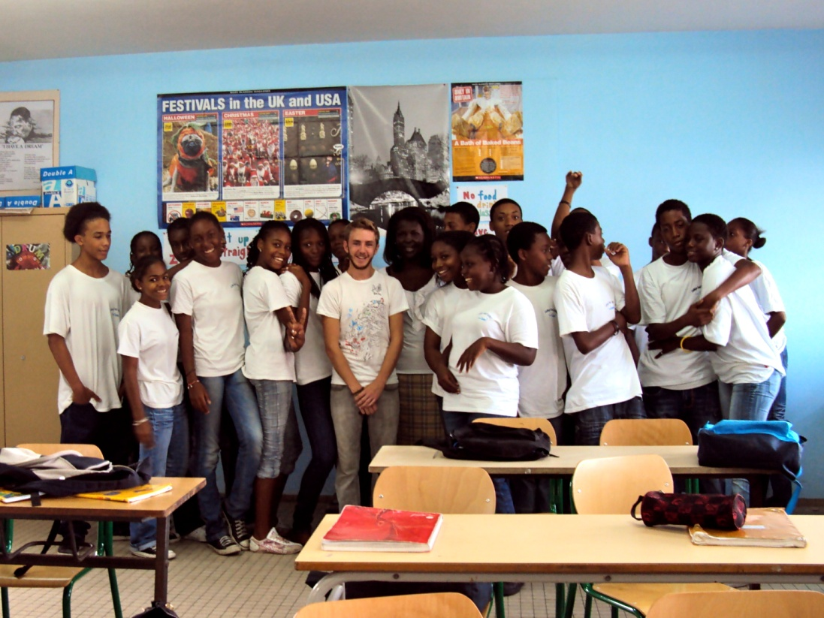
Personal development
Rob Jones, BA (2011), French & Business Studies
English Language Assistant, Guadeloupe

Slide 7
Employability & placements
Languages in the Limelight, Careers & Employability

Slide 8
Personal Development Portfolios
Reluctance of academic staff?
Lack of obvious benefit to students?

Slide 9
Personal Development Portfolios
Anecdotal evidence?

Slide 10
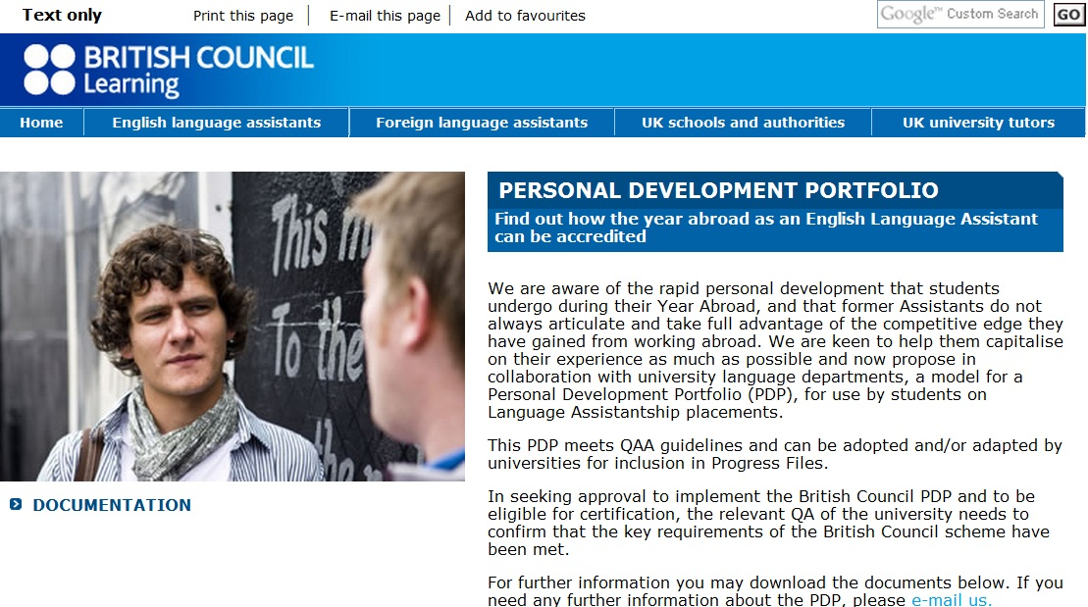
Personal Development Portfolios
The British Council
PDP for
English Language
Assistants

Slide 11
Concluding remarks
Making the most of students returning from placements
Using ‘veterans’
in the application process
in supporting students abroad
in the internationalisation of the campus
Virtuous circle – enhancing their own employability

